Slide 1
BSOA Online System
Module 1-: Editable Website
Module 2 -: Complaint Management System
Module 3 -: Veterans Online platform For Interaction
Module 4 -: App Designing

Slide 2
Editable Website (1)
Drag and Drop Interface to edit the webpage and to perform different formatting
Photo/Video Gallery Category Wise
NEWS & Events Upload Facility with Photographs
Important Forms Upload Facility

Slide 3
Complaint Management System (2)
  Unlimited Tickets/Complaint
  Unlimited Staff
  Unlimited Veterans
  Ticket Categories
  Filters and Sorting / Ticket List
  Ticket Status (Closed/Re-Open Tickets)

Slide 4
Veterans Online platform For Interaction (3)
Veterans registration/ login
Veterans Activation & Listing
Profile photo
Display Veterans (Rank, Name, Unit, Ret. Year, State, City)
Social icons
Veteran Search / Sort options

Slide 5
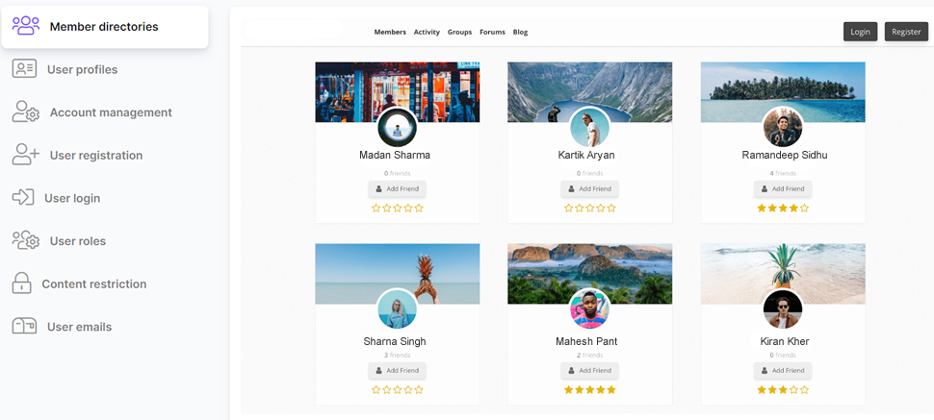
Veterans Online Profile (4)

Slide 6
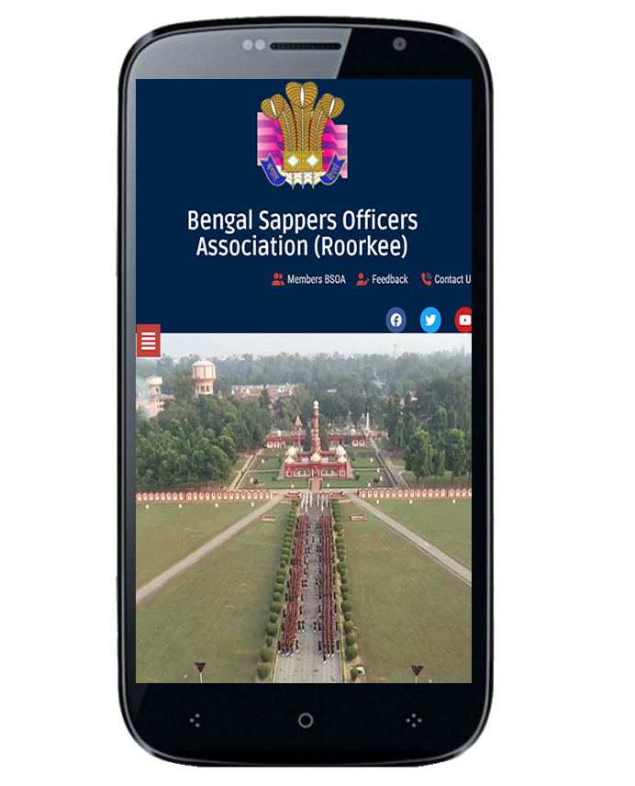
Mobile App designing (5)
Mobile App Designing
for the online system

